Slide 1
Tees Valley Capability Statement

Slide 2
About Mercury3 Consult

Slide 3
About Mercury3 Consult

Slide 4
Our Vision & Values

Slide 5
Our People

Slide 6
Our Services

Slide 7
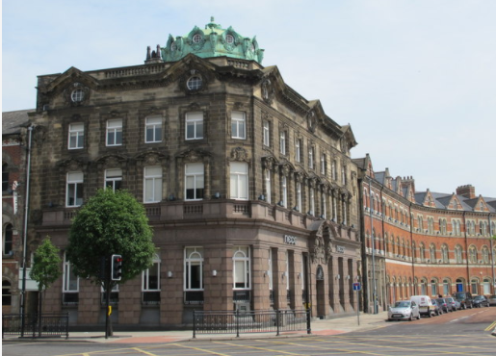
We are local – located in Commerce House Middlesbrough
First Apprentice commenced work and attending Teesside University
Enquiries with Teesside University for Student sponsorship
Honorary member of the Stockton to Darlington Railway
Middlesbrough’s High Street Heritage Action Zone Group Member
Sponsor Zoe’s Place
Tees Valley Combined Authority (TVCA) Employer Advisor
Science Technology Engineering Mathematics (STEM) Ambassador work
Grassroots Rugby
People driven project solutions

Slide 8
Our Clients
Mercury3 Consult deliver expert end to end Project, Programme & Engineering Management services.
Locally and Nationally.
Our range of services include providing individual experts and teams to lead projects; collaborating with our clients and other suppliers to effectively and efficiently deliver.
We are very excited for what the future holds and look forward to working with you

Slide 9
Head Office:
7 Park Row
Leeds
LS1 5HD
Paul Jeffers – Tees Valley Regional Director
Commerce House
1 Exchange Square
Middlesbrough
TS1 1DE
01642 917 341
07940 443 162
Paul.Jeffers@m3consult.co.uk
Trevor Marshall (Director)
07713 453 256
Trevor.Marshall@m3consult.co.uk
Alan Beattie (Director)
07808 804 693
Alan.Beattie@m3consult.co.uk
Ian Watson (Director)
07881 993 232
Ian.Watson@m3consult.co.uk
People driven project solutions

